Slide 1
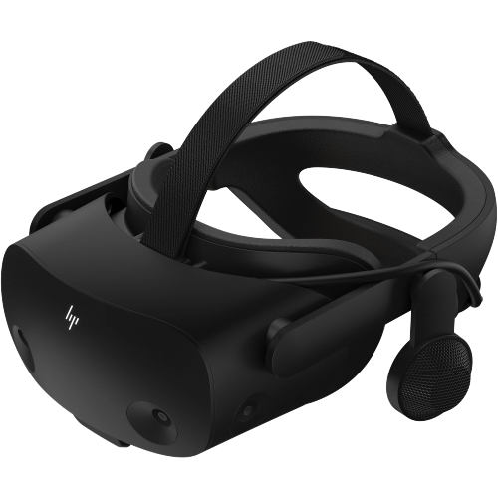
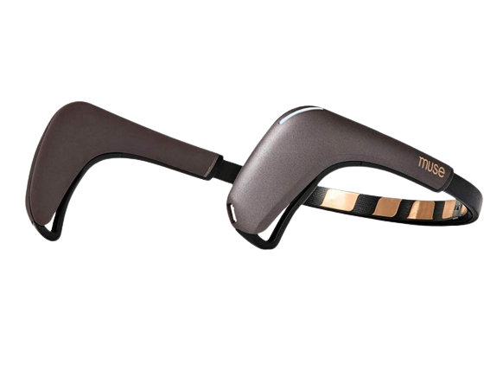
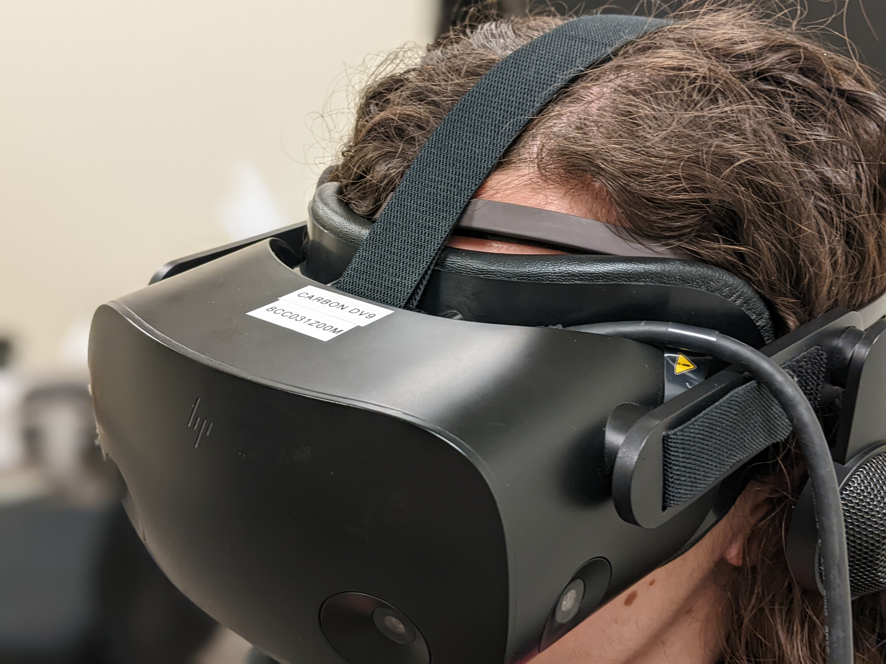

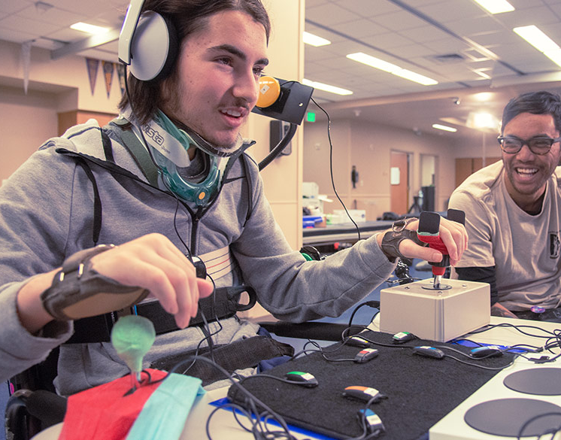

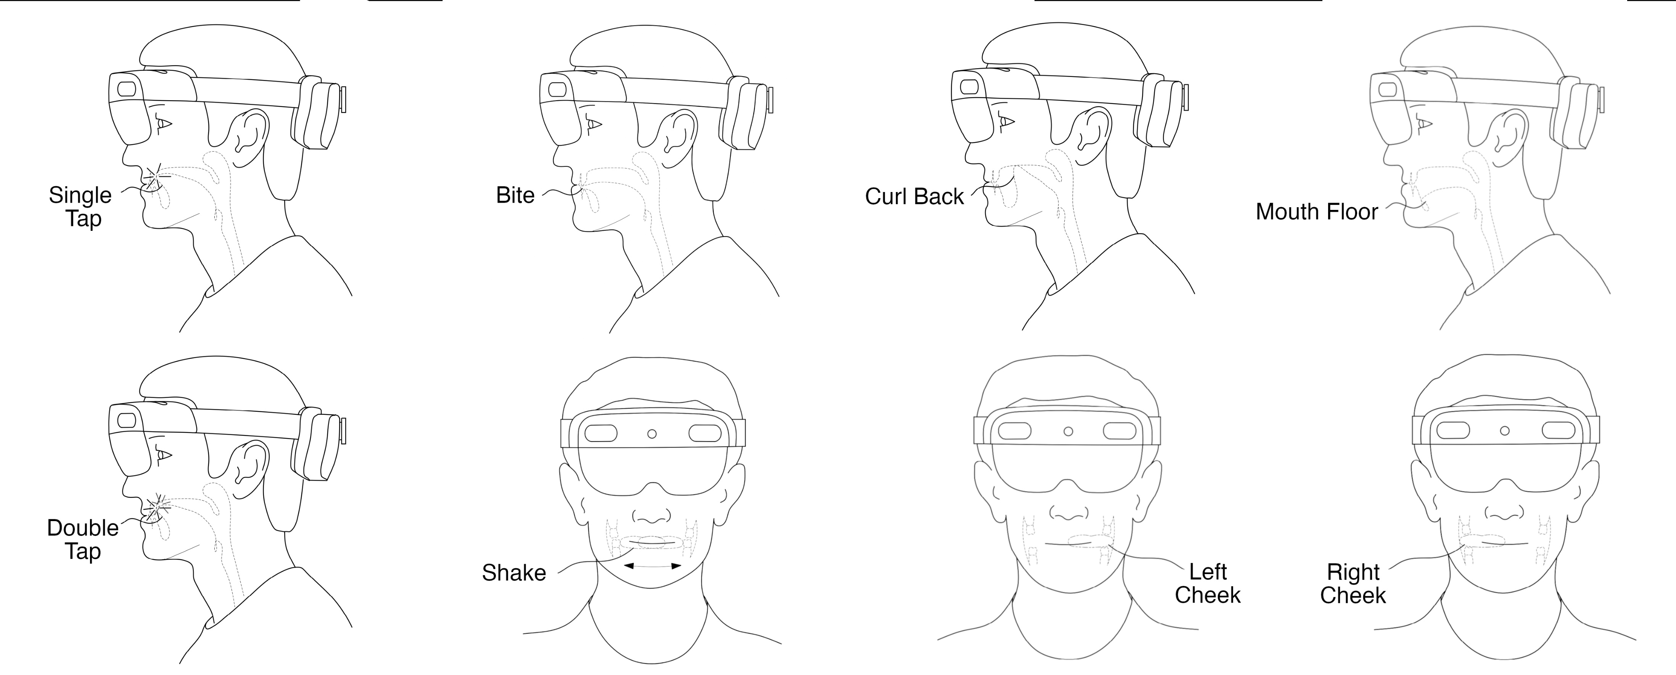



Tongue Gestures for Hands-free Interaction
in Head Worn Displays
Tan Gemicioglu, Mike Winters, Yu-Te Wang, Ivan Tashev
Tongue interfaces don’t need to be near the mouth; we can sense tongue movements from the upper face too.
HP Reverb G2 Omnicept Edition
Muse 2
Why Tongue Interaction?
Hands-Free
Vs. Speech Recognition: Preserves privacy and usable in a wider range of environments
Vs. Gaze Tracking: Less attention demanding, potentially faster than gaze and dwell
Accessible
For a wide range of movement disabilities
For people whose hands are occupied in warehouses, manufacturing and surgeries
Private
Silent and voice-free, usable in spaces that are loud or where speech is inappropriate
Contained within mouth, giving few visual cues
Our interface
Hands-Free
Accessible
Private
Benefits of tongue interaction
Our Tongue Interface
By combining the HP G2 Reverb Omnicept Edition VR headset with the Muse 2 EEG headband, we obtained a multimodal sensing system including:
Eye Tracking
Two IMUs and VR position tracking
PPG (heart rate and variability)
EEG (5 channels)
Mouth Camera
Flowchart of data pipeline from headsets to recognition
Designing Tongue Gestures
Domain | Design Factor | Question
Usability | Accessibility | Which muscles are necessary? With how much force?
 | Privacy | Is the gesture silent? Is it visible visually?
 | Feedback | Does the gesture provide haptic feedback for itself?
 | Simplicity | Is the gesture simple enough to memorize? Can it be performed regularly and quickly?
Recognizability | Signal strength | Is the signal strong enough to separate from noise?
Recognizability | Distinguishability | Is the gesture distinct from other gestures?
 | Rarity | Does the gesture occur naturally in daily activity?
Figure placeholder
Single Tap
Bite
Curl Back
Mouth Floor
Double Tap
Shake
Left Cheek
Right Cheek
Eight tongue gestures selected based on design criteria
QR code
Contact
Tan Gemicioglu
tgemici@gatech.edu
@tangemicioglu
Institution Logo

Slide 2
HP Reverb G2 Omnicept Edition
Muse 2
TongueTap

